Slide 1
Brian Tolleson
James McKinney

Slide 2
Table of Contents Loop Partner Program
01
02
Intro to who we are
How we’re different
03
04
Partnering with us
Stats & reviews

Slide 3
What We Do Managed VoIP Phone Service
Enterprise-class hosted phone service
Simple pricing
No contracts
Fully-managed system
Approachable, relatable support

Slide 4
Who We Are Company Values
our history
Founded in 2009
Headquartered in Charlotte, NC
our values
Empathy
Honesty
Curiosity
Simplicity
Humor
Hard Work
our vision
Loop Communications vows to employ technological expertise and a customer-centric approach to make your business function more efficiently. We think about phones all day, so you don’t have to.
Notes:
We built this company to be a partnership model. We do not consider MSPs to be resellers or an external arm of a sales force.

Slide 5
How We’re Different Customer Service
Obsessive customer support
We manage all changes and configurations
Driven to understand the customer’s intent, so we can recommend the best solution
Clear path to support

Slide 6
How We’re Different Built for SMBs
Simplified installations - phones configured prior to install, so the transition is quick and painless
Processes are designed for speed and efficiency
Infrastructure built for stability and reliability

Slide 7
How We’re Different Not “one size fits all”
Every customer is approached individually, with focus on their needs and the best solution.
Features are released responsibly, knowing they will work as designed and advertised.
Concierge style delivery, customized solutions and integrations to solve challenges and needs.

Slide 8
Partnering With Us We work with your MSP
Partnership gives you expertise in both networking and telecommunications
Clear lines of responsibility
Transparency for your customer
Training and Experience
We are a relationship company

Slide 9
Partnering With Us The Process
Proposal
Onboard
Install
Support
1
2
3
4
Loop &
MSP
Loop
MSP
Loop

Slide 10
Partnering With Us Pricing
hosted phone system
$70 per month
phone extensions
$17 per month
virtual extensions
$7 per month
All features included
Unlimited local / long distance calling
All support and changes included
No contracts
No setup fees, porting fees, etc
E911
$2 per month
local phone numbers
$1 per month
toll free numbers
$20 per month
digital fax
$10 per month

Slide 11
Partnering With Us Included Features
Auto attendants, ring groups, queues, time-based call routing, voicemail to email, operator panel, etc.
Voicemail to text transcription
Call recording
Complimentary professional voiceover
Queue statistics / Call center reporting

Slide 12
Statistics Key Support Metrics
97% of support calls are answered within 15 seconds.
93% of support tickets are solved within ten minutes.
100% SLA achievement of 15-minute response time on overnight and weekend requests.
100% customer satisfaction rating for 24 consecutive months.

Slide 13
Statistics Key Performance Metrics
Coverage across US and Canada.
99.999% uptime for previous 36 months.
Average 2.5 million minutes of phone traffic per month.
Average 900,000 phone calls per month

Slide 14
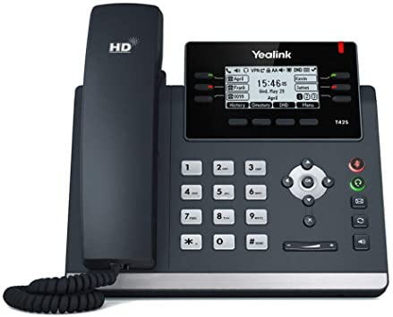
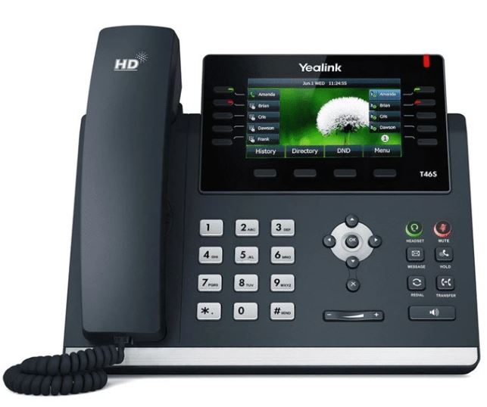
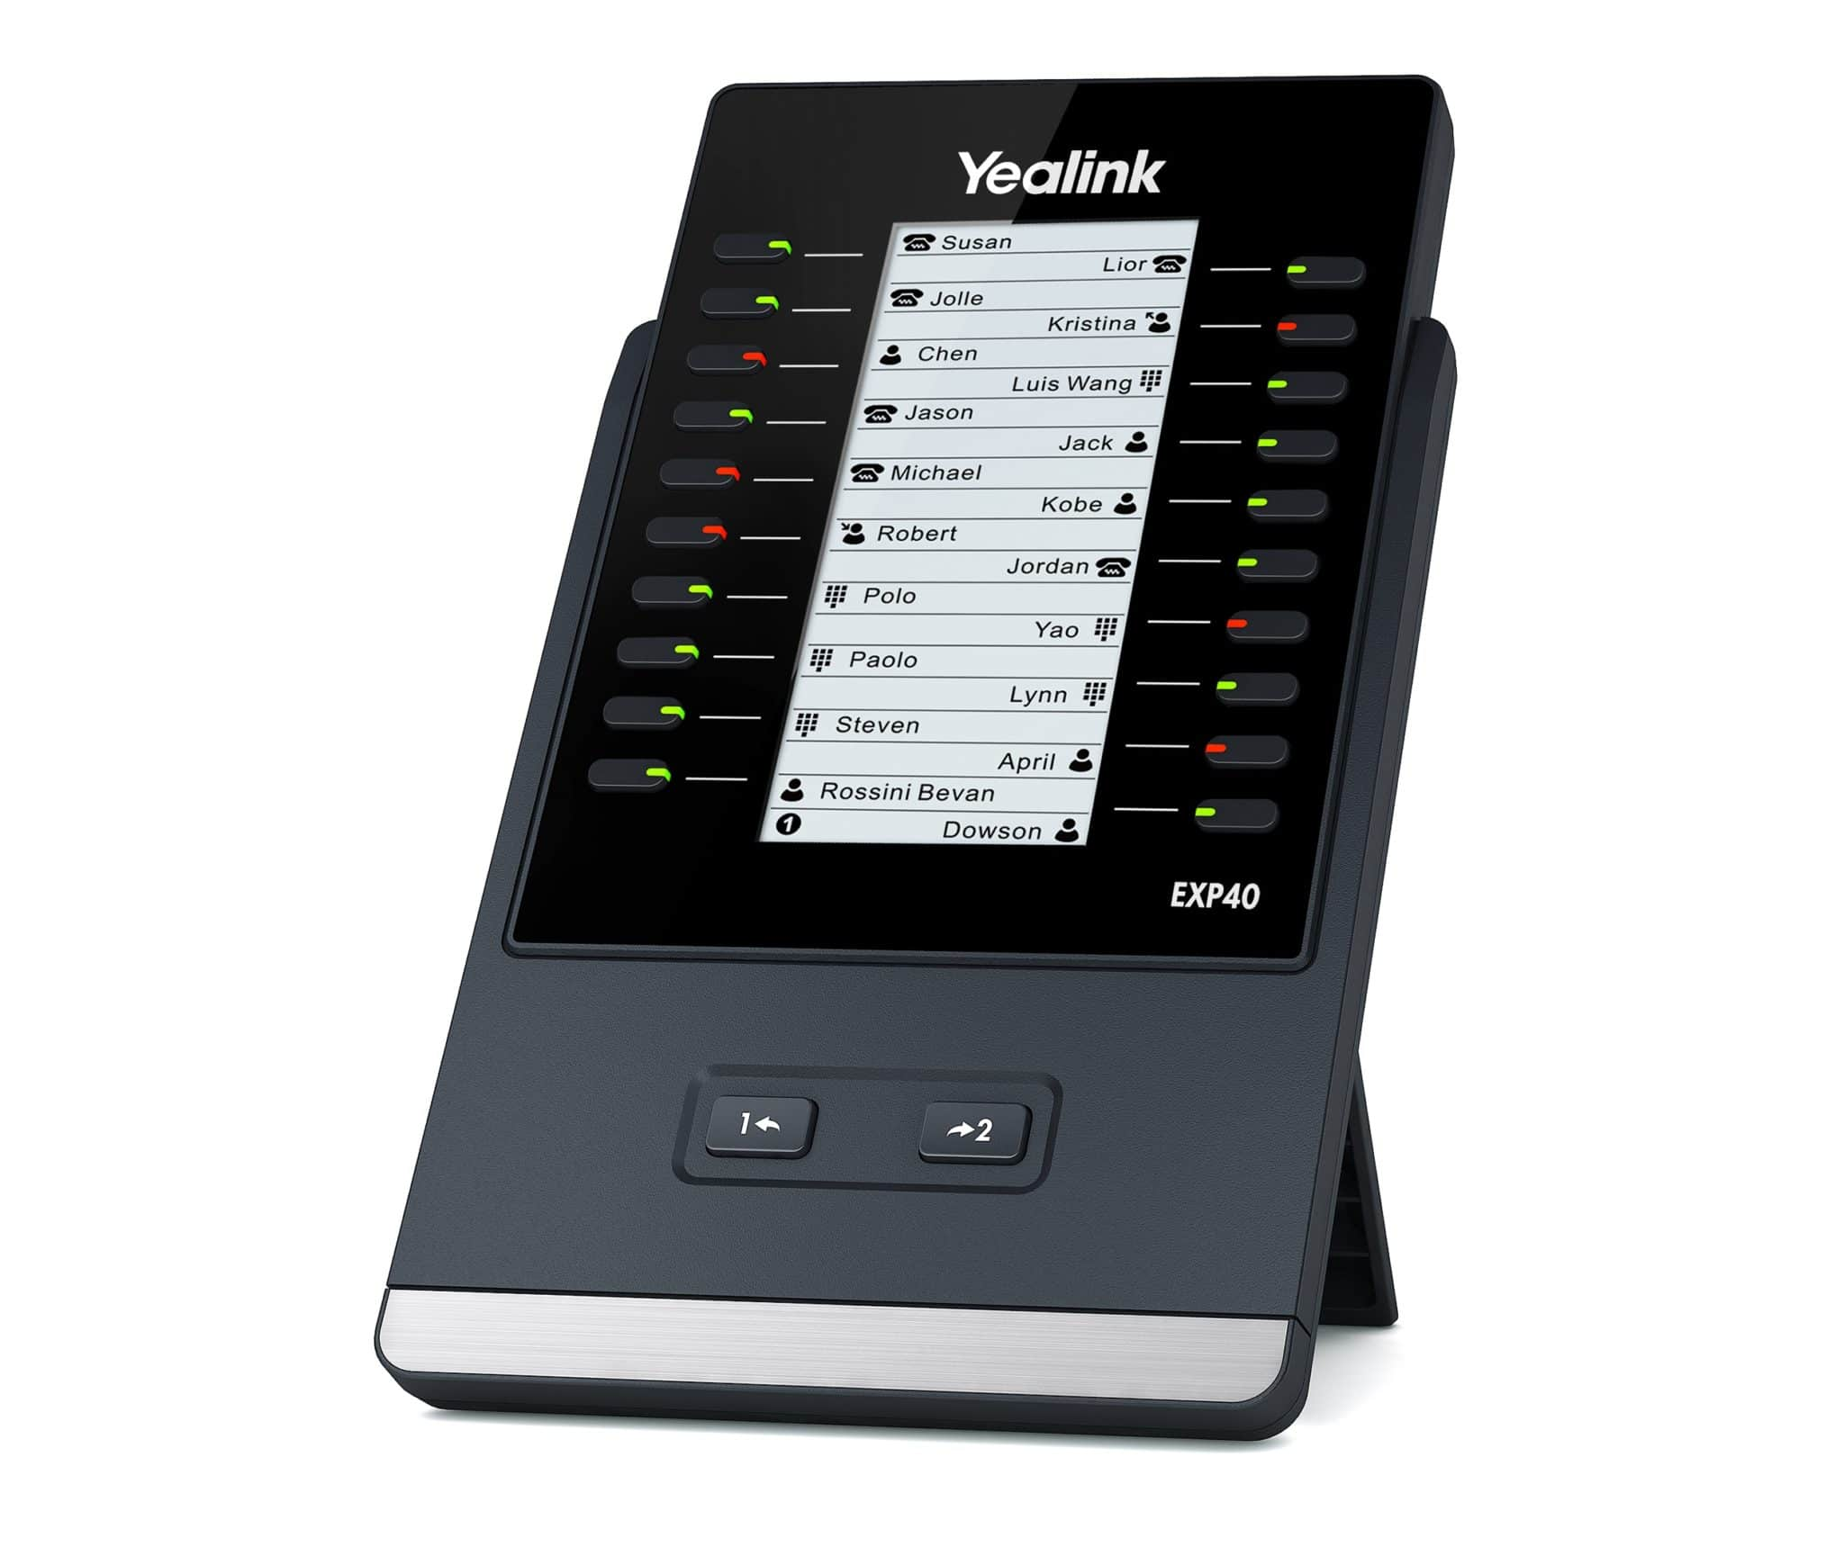
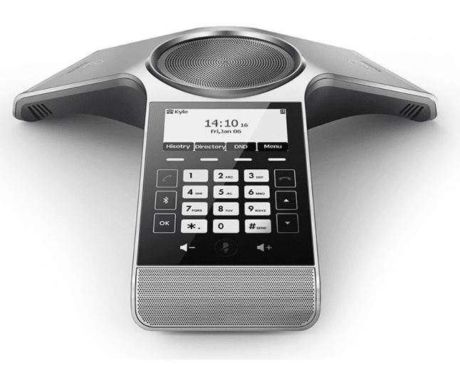
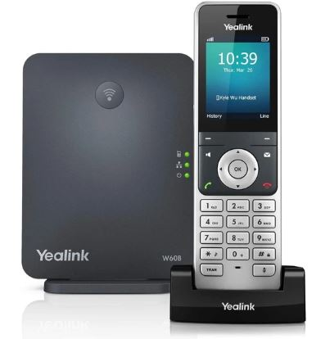
Our Phones All With Great Call Quality
Desk Phone
Color Desk Phone
Side Car Directory
Conference Room Phone
Wireless Phone

Slide 15
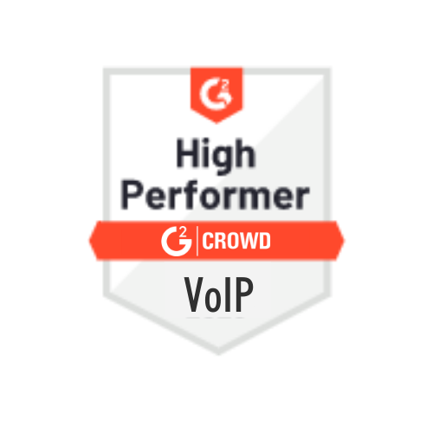
Independent Reviews G2 Crowd
#1 in Quality of support
99% loop vs 83% industry avg
#1 in Ease of doing business with
99% loop vs 84% industry avg
#1 in Likelihood to recommend
G2 Crowd is the world’s largest B2B software evaluation platform.
The ratings are based on
unfiltered, unbiased, 100% validated reviews.
96% loop vs 82% industry avg
#1 in Ease of use
96% loop vs 86% industry avg
Notes:
We built this company to be a partnership model. We do not consider MSPs to be resellers or an external arm of a sales force.

Slide 16
“Great customer service! Friendly and fast!”
“Real customer service in a day and age where it is ignored.”
“We love LOOP!”
“I love how responsive they are to my calls or emails when I need service!
But more importantly, I love that my phones are never down! With our previous provider, we were experiencing weekly outages!”
Loop makes it very easy to get in touch with them. Their employees are very helpful in providing steps to solving problems, and they are happy to jump in and work on the problem first-hand.”
“Customer service is critical to us. Loop has been exceptional from walking us through each step to answering questions. They are exceptional”
Kelly Speers
President @ Your IT Results
Joelle Ferguson
Manager @ Ferguson Insurance
Danielle Bales
Manager @ Way Media

Slide 17
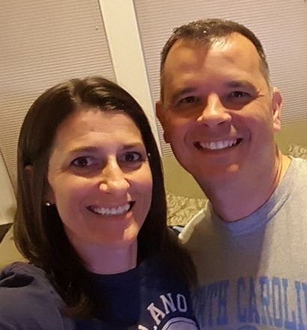
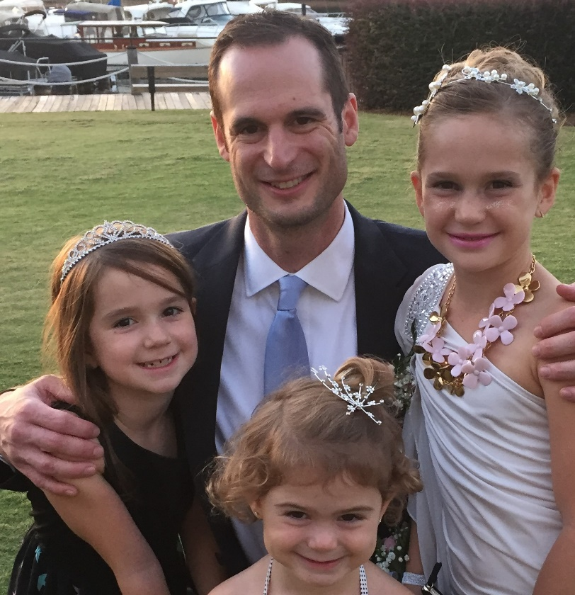
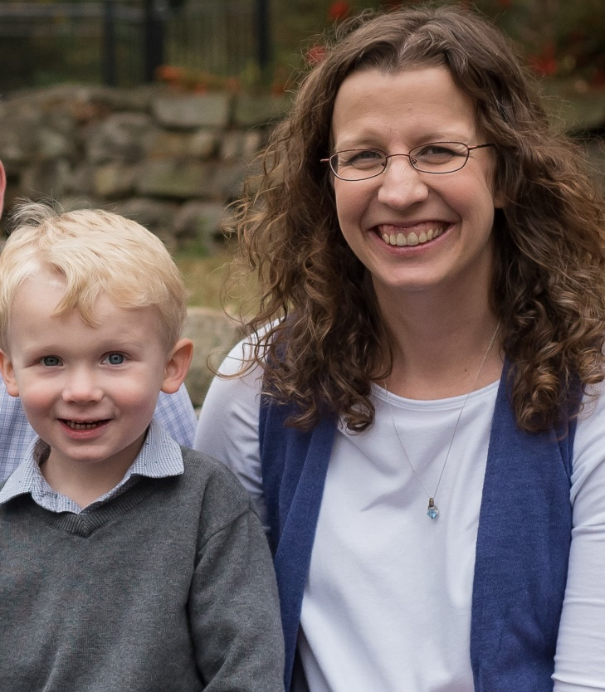
Loop Communications Leadership Team
James McKinney
President
Brian Tolleson
CEO
Amanda Proffitt
Director of Operations
sales@loopcommunications.com
800-586-0320

